Slide 1
Case Study: Subrogation of Insurance Claim
Gaurav Sitaula
Ali Shakiba
Rezwan Islam

Slide 2
Context
Prediction of insurance claims to subrogate
Detecting the cases where wining chance in very high

Slide 3
Other Variables
Body part involvement
Nature of damage
Cause of Claim
Vehicle involvement

Slide 4
Question
Does text mining (“Adjuster Notes”) improve the prediction?

Slide 5
Exploratory Data Analysis

Slide 6
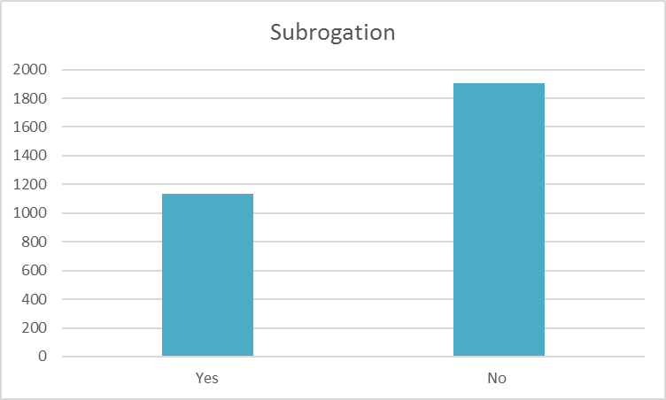
Exploratory Data Analysis

Slide 7
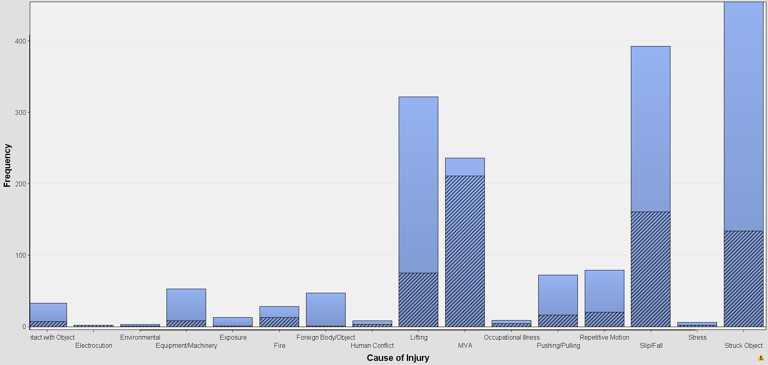
Exploratory Data Analysis

Slide 8
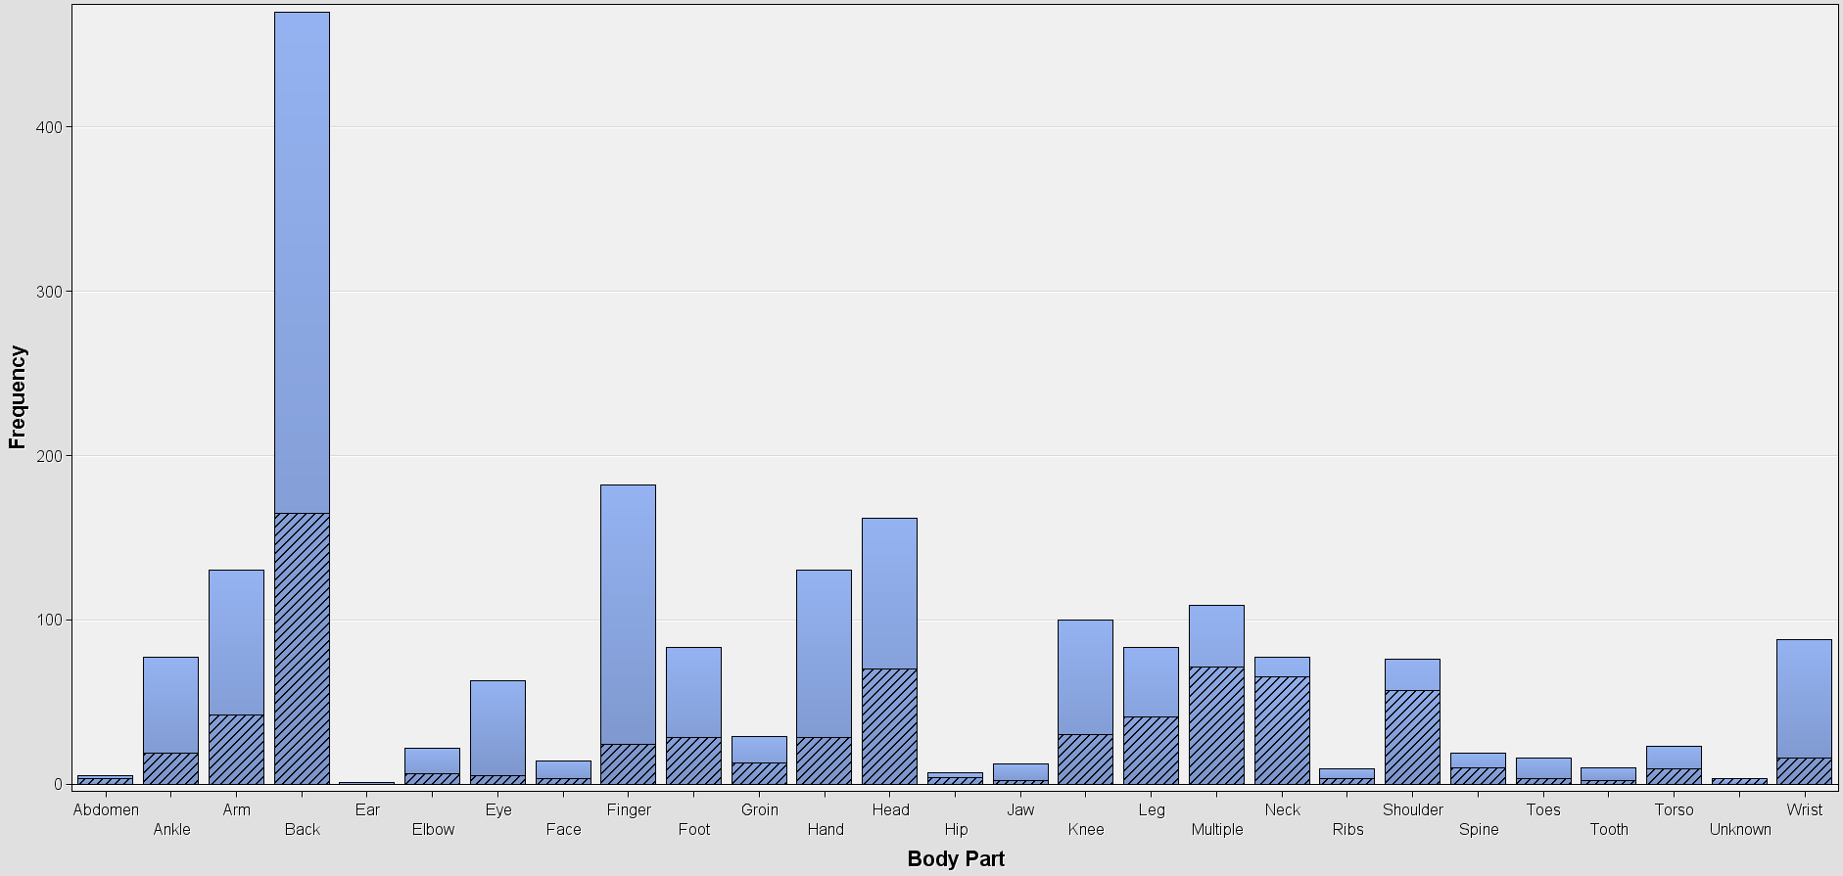
Exploratory Data Analysis

Slide 9
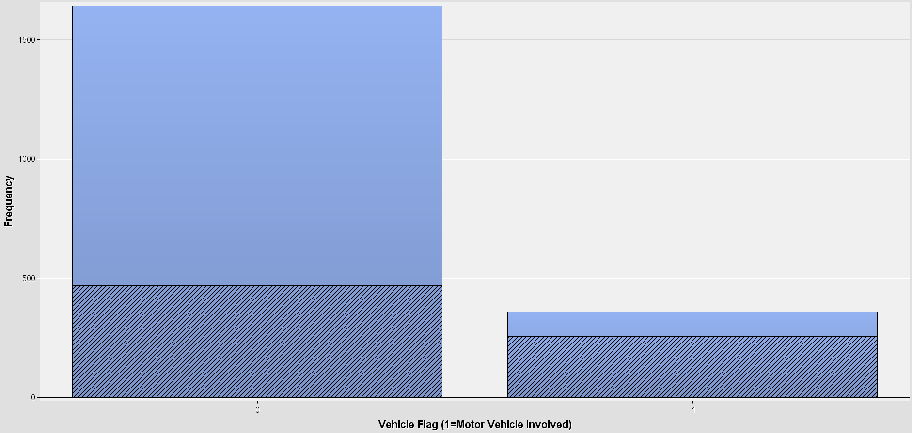
Exploratory Data Analysis

Slide 10
Data Analysis Workflow

Slide 11
Data Analysis Workflow
Text Mining
Model Building
Performance Evaluation

Slide 12
Predictive Model Explanation

Slide 13
Best Model
Tried 3 Decision Trees and 3 Logistic Regressions
The best: Logistic Regression

Slide 14
Categorical Variables (Higher Odds Ratio)
MVA
Occupational Illness
Fire
Exposure
Human Conflict
Electrocution

Slide 15
Categorical Variables (Lower Odds Ratio)
Animal Attack
Environmental Cause
Lifting
Pushing/Pulling
Foreign Body

Slide 16
Text Mining Analysis
(Terms to Subrogate)
Automobile Accident
Auto
Accident
Car Accident
Motor

Slide 17
Text Mining Analysis
(Terms to Subrogate)
Injury
Fall
Neck Pain
Strained Neck
Shoulder
Employee

Slide 18
Text Mining Analysis
(Terms Not to Subrogate)
eye
finger
thumb
hand
ankle
foot
walk
bite
slip
twist
lift
clean
box
unload
pull
catch
sharp
cut
smash
glass
door

Slide 19
Final Conclusion

Slide 20
Conclusion
Text mining ultimately improves the predictive modelling

Slide 21
Recommendation

Slide 22
Recommendations
Subrogate: If the claim adjuster notes contain anything related to Motor/Auto Vehicle Accident
1
Subrogate: If the claim adjuster notes contain anything related to Neck/Shoulder Injury
2
Not Subrogate: If the damage is caused by the claimant himself, an object or an animal
3

